Slide 1


LOLCODE
ESOTERIC LANGUAGE
Josh Mathews, Mitchell Bohn, Amanda Smith

Slide 2
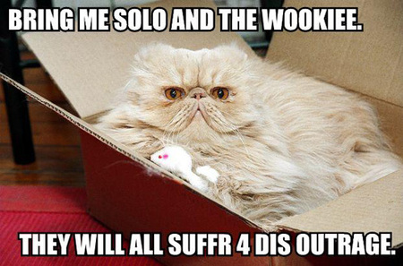
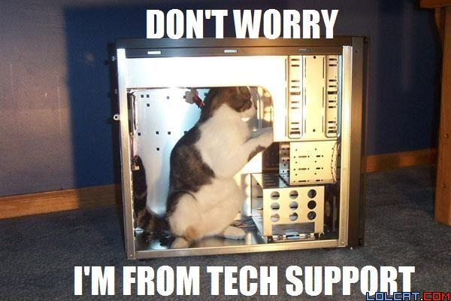
Overview
Environment and Audience
Documentation, Debugging
Language Information
Research and Review

Slide 3

ESOTERIC LANGUAGES
Language to test the boundaries of language designs, to be a proof of concept, to accomplish a singular task, or to be a joke.
LOLCODE - III
Notes:
What is an Esoteric Language?
* Josh?

Slide 4
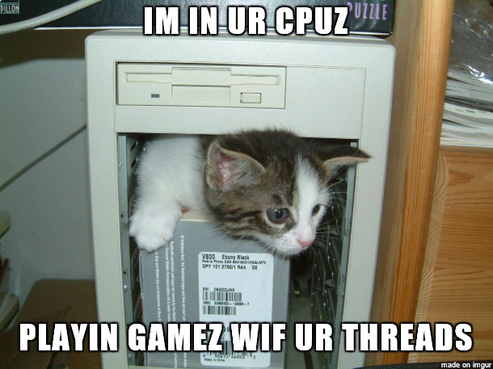
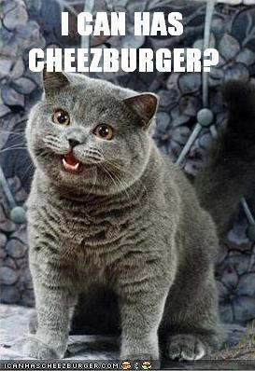
LOLCATS
INTERNET
MEME
Lolcats images comprise a photo of a cat with a large caption characteristically set in a sans serif font such as Impact or Arial Black. The image is, on occasion, digitally edited for effect.
LOLCODE began as PHP parser
Notes:
Why are there cheezeburger?
Roughly explain what the LOLCAT language is coming from.

Slide 5




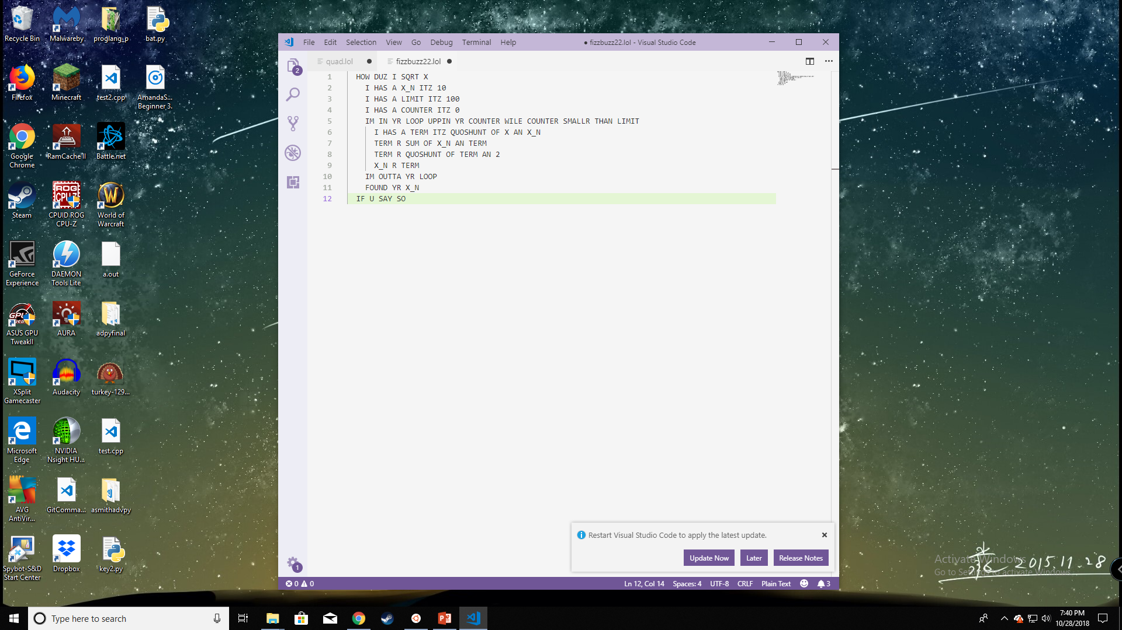
Paradigms
Audience
Environment
Imperative, block structure.
It isn’t a serious language.
Meant for audiences who enjoy writing like they’re in 8th grade, or are just very, very bored.
Authors reached their audience!
LCI Command-line interpreter
Not limited to specific editor/no IDE
VSCode has pretty colors….sometimes
Online interpreter: repl.it

Slide 6



Documentation
Github – README’s and a few reworded pieces on Wikipedia
1.2 is most used (last update: pull request 2017)
1.3 is most stable? Is any of this stable?
1.4 has some cool features, others are broken
https://github.com/justinmeza/lolcode-spec/blob/master/v1.2/lolcode-spec-v1.2.md
LOLCODE - VI
Notes:
What is the documentation like?
Bare essentials for the language to be able to code it, and points out a few weak points in places they haven’t decided on how to handle issues.
Docs are in the form of README’s in markdown on Github, and regurgitated on Wikipedia
Is this implementation dependent or part of the language design?
FIXME

Slide 7
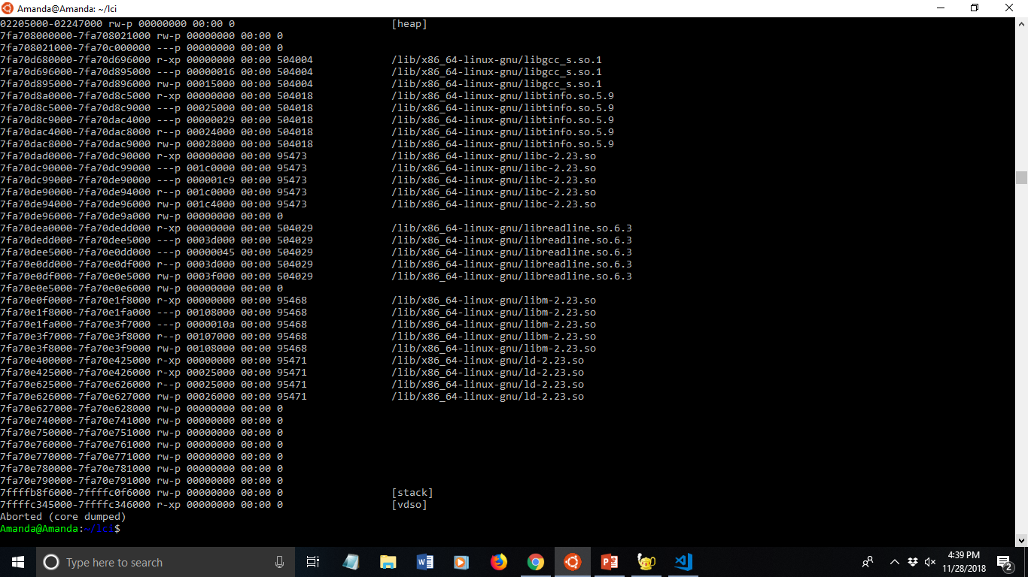
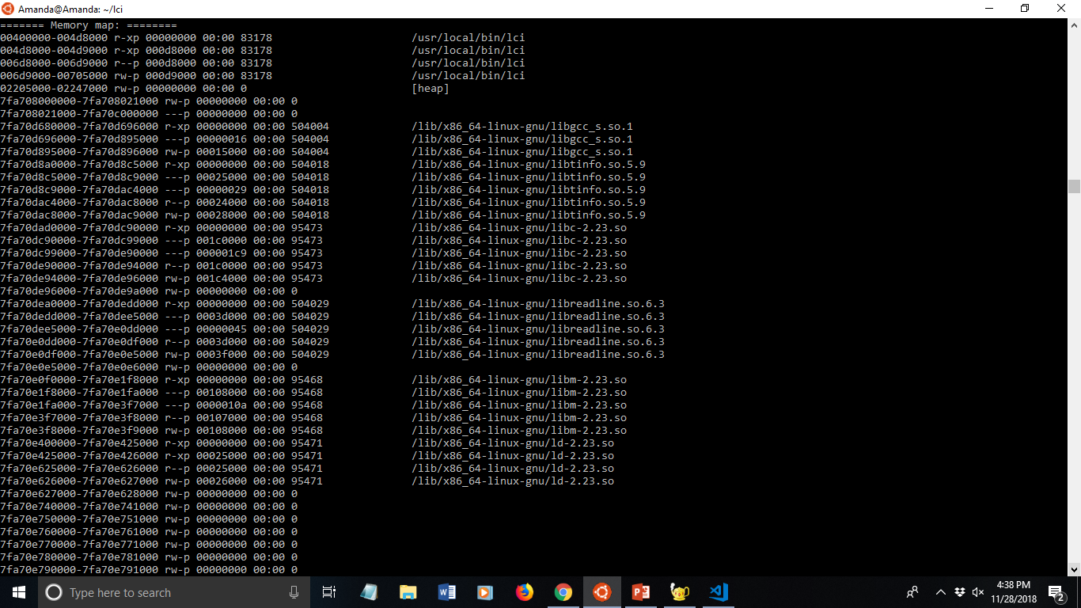
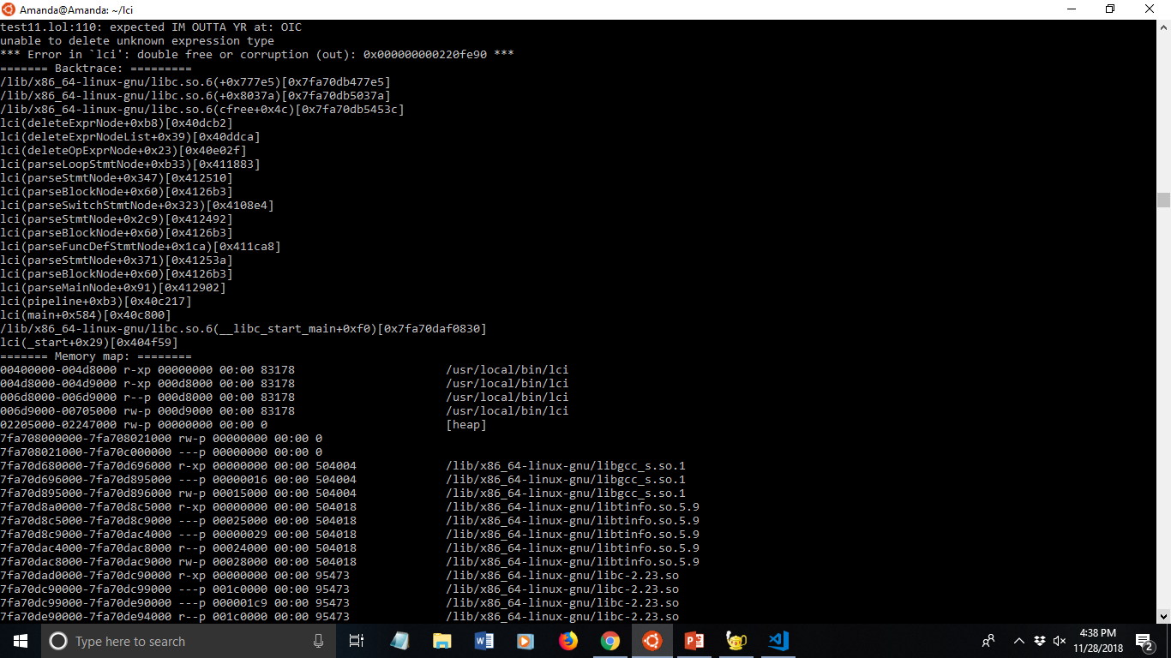

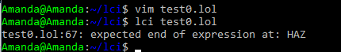
DEBUGGING
Ease and Response
Error responses aren’t terribly specific, but it provides enough details to get by
No debugger, must do by hand; usually fairly easy
`Missing a KTHXBYE at end of file`
There is no syntax help while writing the code;
All errors must be found when attempting to build and run
LOLCODE - VII
Notes:
The language is about as easy to debug as Python. Which means sometimes, you may know what the problem is. Other times, you may be googling for hours.
Errors can also just say core dumped with a whole bunch of garbage output.

Slide 8




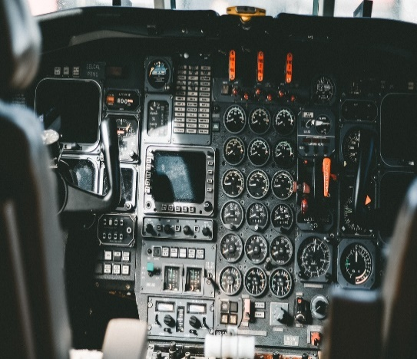

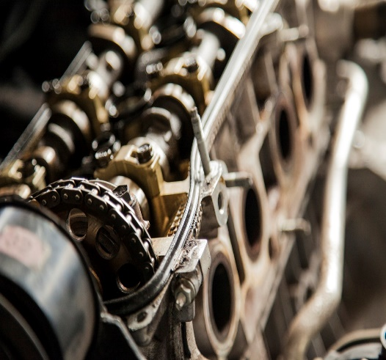
PRINCIPLES
Keys of Language
Most of the applications for the main principles of the language have a twist on them. This language is very unique in it’s readability and writability. Since it’s esoteric, however, it’s got some major problems with security and reliability.
LOLCODE - IIX
Notes:
Readability
Unique linguistic styling makes code interesting easy to read
Blocks marked by a ‘begin’ and ‘end’ or sorts, it’s easy to follow logic
Some instruction names do not lend themselves to their actual use ( ‘omg/wtf’)
Writability
Writing is a disaster of sorting through the documents
Some normal operations (like array[i]) are nightmares and have been done very little, so there isn’t much online help)
Fun to write, no matter how disastrous
Simplicity/Expressiveness
Has very simple tray of operations.
Few data types
Base language has the base operations/loops/function ability
Portability
We had issues with this one
Copying projects from online would rarely work
Even uploading to Github and pulling for some would wipe the files
Security
Josh (>*^*)> Git ur shit together
Extensibility
People had have success importing major additional libraries, such as ‘stdio’
Issue becomes naming conventions and using the imports
Issues handled case by case

Slide 9
PRINCIPLES
Continued
Simplicity & Extendibility
Readability & Writability
Unique word choice makes it fun to read and terrible to write
Annoying inconsistency in certain words like HAZ and HAS
I HAS A variable ITZ 0
I HAZ function-call MKAY
Very simple language with few data types, loop and control structures and Few constructs allows for some pre-structured extended libraries (I/O and string)
Notes:
Readability
Unique linguistic styling makes code interesting easy to read
Blocks marked by a ‘begin’ and ‘end’ or sorts, it’s easy to follow logic
Some instruction names do not lend themselves to their actual use ( ‘omg/wtf’)
Writability
Writing is a disaster of sorting through the documents
Some normal operations (like array[i]) are nightmares and have been done very little, so there isn’t much online help)
Fun to write, no matter how disastrous
Simplicity/Expressiveness
Has very simple tray of operations.
Few data types
Base language has the base operations/loops/function ability

Slide 10
PRINCIPLES
Continued
Portability
Security & Reliability
Various group members had different problems
Could never copy and paste online code
Docs say portability is a perk of the language (it’s supposed to be good)
What security?
You’re never sure if you need spaces, tabs, or end of line statements even though it defines it at the start of the documents
Iffy if your variable name is a reserved word or not
Some things do not operate the way you might think (case; breaking out of loops)
Notes:
Portability
We had issues with this one
Copying projects from online would rarely work
Even uploading to Github and pulling for some would wipe the files
Security

Slide 11
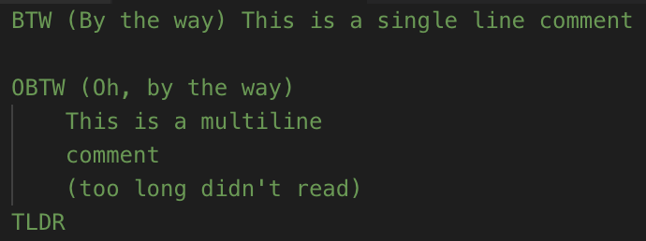
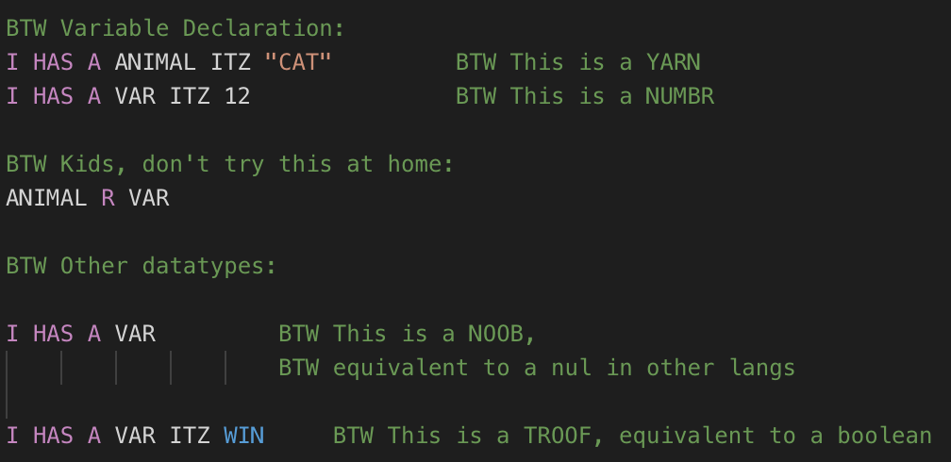
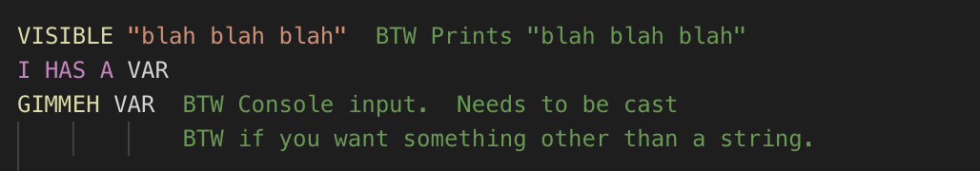
Code Structures
Comments
Variable Declaration
I/O
LOLCODE - XI

Slide 12
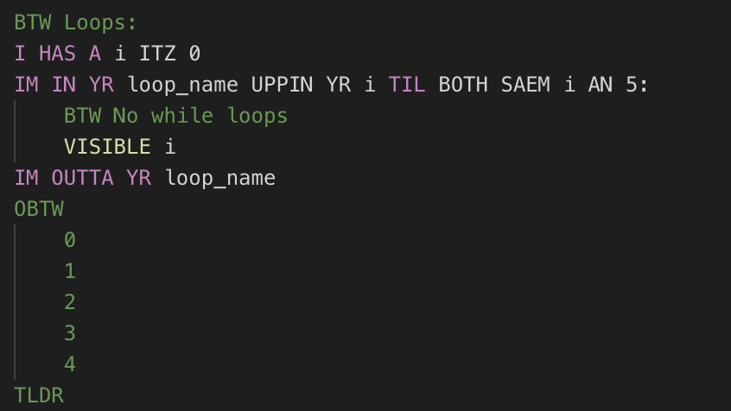
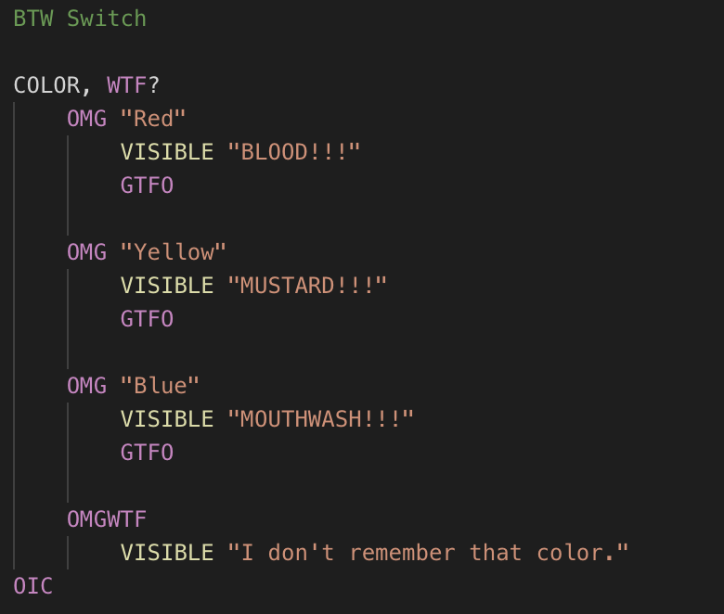
Code Structures
Loop
Switch
LOLCODE - XII

Slide 13
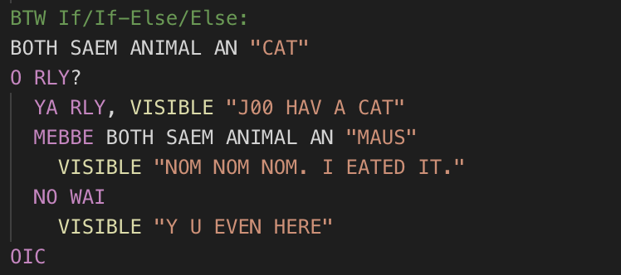
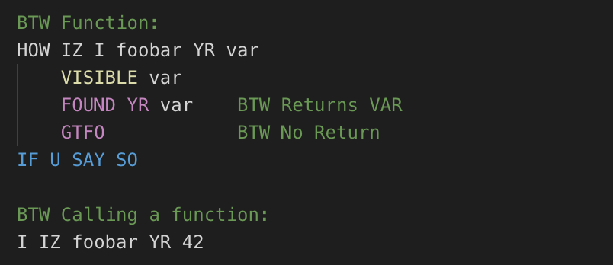
Code Structures
If/Else
Function Declaration
LOLCODE - XIV

Slide 14
Language
Static v. Dynamic
LOLCODE - XII
Data Types
Are dynamic variables allowed?
Cons
What data types are allowed?
What does the language do bad?
“Variables are dynamically typed”
NOOB (untyped), NUMBR (int), NUMBAR (float), YARN (string), TROOF (Boolean), BUKKIT (array or struct)
Pros
What does the language do well?
Be reliable – floats, doubles, looping
Not esoteric enough (by definition)
Linguistics and entertainment

Slide 15

Cost
The language is free to use, but has costs other than strictly currency
Time cost: Time to set up compiler (hardware dependent)
Factors
Cost and Limitations
Hardware
Has some software limitations
Linux/WSL only
No noticeable hardware limitations
*All of us are using high powered machines
LOLCODE - XIIV
Notes:
Can probably memorize and summarize to present. Rather easy.

Slide 16

I Can Has Supercomputer?
A Novel Approach to Teaching Parallel and Distributed Computing Concepts…
LOLCODE - XIV
im in ur programmz, codin in ur dialect: LOLCode and Feline Dialectology
Research
Comments on style and creativity of language
Gives summary of language components
Key Findings
Notes:
http://wstyler.ucsd.edu/posts/in_ur_programmz.html
https://arxiv.org/ftp/arxiv/papers/1703/1703.10242.pdf
TODO:
Summarize Research

Slide 17

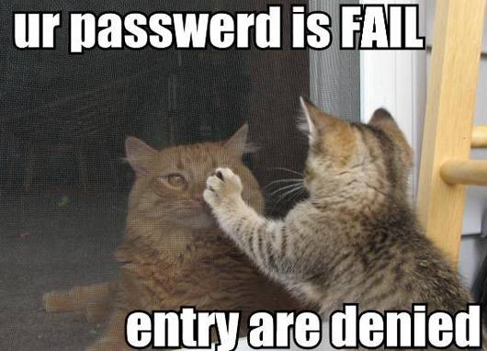
Impression
Notes:
Amanda:
Use Case:
To have fun when you have nothing else to do.
To show off that you can learn something totally out there.
Did I like writing in it:
It’s fun for something to mess around in your free time, but it did take a while to get used to.
Mitchell:
Use Case:
Trying something new and seeing what is possible.
Laughing at stupid jokes with friends.
Programming language presentations.
Did I like?
I was very fascinated with what programmers managed to put their minds to and how far this was pushed.
seemed like it was very short lived and won’t make much headway fast.
Josh:
Use Case:
A
Did I like?
B

Slide 18

KTHXBYE
HAZ U ANY KWESTIONS?

